Slide 1
RNN & LSTM

Slide 2
RNN Architecture
y
Y_{t-1}
Y_{t}
Y_{t+1}
w_{y}
w_{y}
w_{y}
h
H_{t-1}
w_{h}
H_{t}
w_{h}
H_{t+1}
w_{h}
w_{x}
w_{x}
w_{x}
X
X_{t-1}
X_{t}
X_{t+1}
t = time stamps
X = input
H_{t} = Hidden state
Y = output

Slide 3
RNN Architecture
y
Y_{t-1}
Y_{t}
Y_{t+1}
w_{y}
w_{y}
w_{y}
h
H_{t-1}
w_{h}
H_{t}
w_{h}
H_{t+1}
w_{h}
w_{x}
w_{x}
w_{x}
X
X_{t-1}
X_{t}
X_{t+1}
My
name
Alamin
In every timestamps we will pass one word at a time.
One think here we have to pass every word as a numerical vector.

Slide 4
Actual diagram of RNN
Let’s make a sample sentiment dataset
Review | Sentiment
X₁ -> Movie(x₁₁) was(x₁₂) good(x₁₃) | 1
X₂ -> Movie(x₂₁) was(x₂₂) good(x₂₃) | 0
X₃ -> Movie(x₃₁) was(x₃₂) good(x₃₃) | 0
For every unique word one hot encoding is, you can use different technique. We doing is because we know Deep learning model only understand numbers.
Movie | [1 0 0 0 0]
Was | [0 1 0 0 0]
Good | [0 0 1 0 0]
Bad | [0 0 0 1 0]
Not | [0 0 0 0 1]

Slide 5
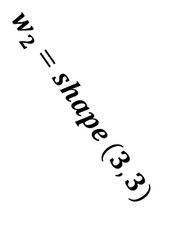

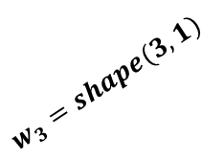
Actual diagram of RNN
5 input node
& 3 hidden node
$$w_{1}=shape (5, 3)$$
Same Node
Weight = w
T1
Movie
[1 0 0 0 0]
$$w_{2}=shape (3, 3)$$
Input Node
Hidden Node
Memory Node
$$w_{3}=shape(3, 1)$$
T2
Was
[0 1 0 0 0]
$$number of bias=1 for 1 nodes$$
Output Node
Calculate Trainable param
Total weight = w1 + w2 + w3 + bias
= 15 + 9 + 3 + 4 bias
= 27 + 4 bias
$$number of bias=3 for 3 nodes$$
Note: Here, I just took two words for demonstration purpose.

Slide 6
Forward Propagation of RNN
Let’s make a sample sentiment dataset
Review | Sentiment
X₁ -> Movie(x₁₁) was(x₁₂) good(x₁₃) | 1
X₂ -> Movie(x₂₁) was(x₂₂) good(x₂₃) | 0
X₃ -> Movie(x₃₁) was(x₃₂) good(x₃₃) | 0
Here, every (x_{ij}) is a vector with five dimensional and shape is (1, 5).
In forward operation time a concept are follow that is called unfolding through time. Which is basically fancy
Way to saying it just work (recurrent layers) as a loop.
We know that every node contain a activation function. By default in RNN used tanh activation function.
Note: Here, we used the same weights for every timestamps.

Slide 7



Forward Propagation of RNN
O_{i} = Output of the Node
Y_{t+1}
$$for t_{1}=O_{1}=activationFun(x_{11}w_{x}+O_{0}w_{h}+b_{1})$$
w_{y}
$$=activationFun(\left(1, 5\right)\left(5, 3\right)+(1, 3)(3, 3)+b_{1})$$
H_{t-1}
O₁
H_{t}
w_{h}
H_{t+1}
w_{h}
O₂
$$=activationFun(\left(1, 3\right)+(1, 3)+b_{1})$$
w_{x}
w_{x}
w_{x}
$$=activationFun(\left(1, 3\right)+b_{1})$$
X₁₁
_{T1}
X₁₂
_{T2}
X₁₃
_{T3}
$$for t_{2}=O_{2}=activationFun(x_{12}w_{x}+O_{1}w_{h}+b_{1})$$
$$=activationFun(\left(1, 5\right)\left(5, 3\right)+(1, 3)(3, 3)+b_{1})$$
$$=activationFun(\left(1, 3\right)+(1, 3)+b_{1})$$
$$=activationFun(\left(1, 3\right)+b_{1})$$
$$for t_{3}=O_{3}=activationFun(x_{13}w_{x}+O_{2}w_{h}+b_{1})$$
w_{f}
$$=activationFun(\left(1, 5\right)\left(5, 3\right)+(1, 3)(3, 3)+b_{1})$$
$$=activationFun(\left(1, 3\right)+(1, 3)+b_{1})$$
$$=activationFun(\left(1, 3\right)+b_{1})$$

Slide 8



Forward Propagation of RNN
O_{i} = Output of the Node
Y_{t+1}
$$final output=activationFun(O_{3 }w_{f}+b_{2})$$
w_{y}
O₁
w_{h}
$$=activationFun((1, 3)(3, 1)+b_{2})$$
H_{t-1}
H_{t}
H_{t+1}
w_{h}
O₂
$$=activationFun(\left(1, 1\right)+b_{2})$$
w_{x}
w_{x}
w_{x}
$$=get scaler value (1)$$
X₁₁
_{T1}
X₁₂
_{T2}
X₁₃
_{T3}
A single RNN Architecture
w_{f}

Slide 9
Problem with RNN
Recurrent Neural Networks (RNNs) are a type of neural network architecture commonly used for sequential data processing tasks, such as natural language processing and time series analysis. However, RNNs have several limitations and problems, which have led to the development of more advanced architectures like Long Short-Term Memory (LSTM) and Gated Recurrent Unit (GRU). Here are some of the key problems associated with basic RNNs:
Vanishing Gradients: RNNs are prone to the vanishing gradient problem, where gradients become very small as they are backpropagated through time during training. This issue makes it difficult for the network to learn long-range dependencies in sequences.
Exploding Gradients: Conversely, RNNs can also suffer from exploding gradient problems, where gradients grow exponentially during training. This can lead to numerical instability and make training difficult.
Short-Term Memory: Basic RNNs have a limited ability to capture long-range dependencies in sequences. They are often better suited for modeling short-term dependencies but struggle with tasks requiring a longer context.

Slide 10
Problem with RNN
Lack of Selective Memory: RNNs do not have a mechanism to selectively remember or forget information from the past. This can be a problem when the model needs to focus on relevant information and ignore irrelevant or outdated information.
Inefficient Parallelization: RNNs are inherently sequential in nature, which makes them less efficient to parallelize compared to other architectures. This can lead to longer training times.
To address these problems, more advanced recurrent architectures like LSTM and GRU were introduced. LSTM, in particular, is designed to mitigate the vanishing gradient problem and has mechanisms for selectively remembering and forgetting information, making it better suited for capturing long-range dependencies in sequences.

Slide 11
LSTM
Long Short-Term Memory (LSTM) is a type of recurrent neural network (RNN) architecture that was introduced to address some of the limitations of traditional RNNs. LSTMs are specifically designed to capture long-range dependencies in sequential data and mitigate the vanishing gradient problem, which can hinder the training of RNNs. LSTMs are widely used in various applications, including natural language processing, speech recognition, and time series forecasting. Here's an overview of LSTM:
Memory Cells: The core of an LSTM network is its memory cell. This cell can maintain a hidden state over a long sequence, which allows it to capture long-term dependencies. The memory cell can be thought of as a conveyor belt, where information can be added or removed, and it runs parallel to the sequence.
Gates: LSTMs have three types of gates that control the flow of information into and out of the memory cell:
Forget Gate: This gate determines what information from the previous cell state should be forgotten or retained. It takes the previous cell state and the current input as input and produces a forget gate output.

Slide 12
LSTM
Input Gate: This gate decides what new information should be stored in the memory cell. It takes the current input and produces an input gate output.
Output Gate: The output gate determines what information from the current cell state should be passed to the output. It considers the current input and the cell state to produce the output gate output.
Cell State: The memory cell maintains a cell state, which can be thought of as a kind of internal memory. The cell state can be updated using the information from the input gate and the forget gate. This allows the network to remember or forget information selectively.
Hidden State: The LSTM also has a hidden state that can be thought of as the output of the LSTM at each time step. The hidden state is produced using the cell state and the output gate.
The key advantages of LSTMs are their ability to capture long-term dependencies and their resistance to the vanishing gradient problem. The gates in LSTMs allow them to regulate the flow of information, making them well-suited for tasks that involve sequences of data where information from the distant past is relevant to the present.

Slide 13
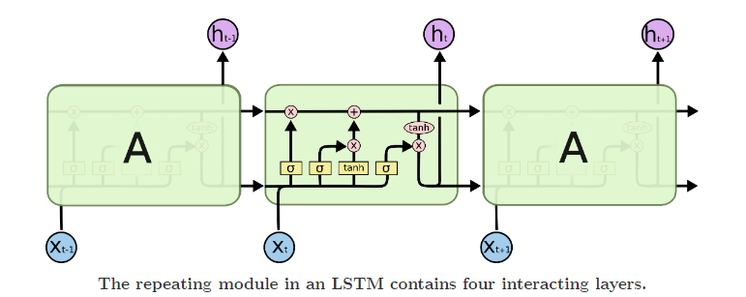
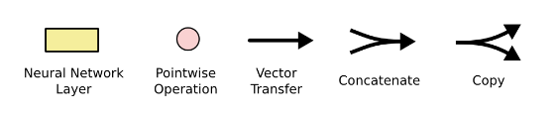
LSTM Architecture

Slide 14
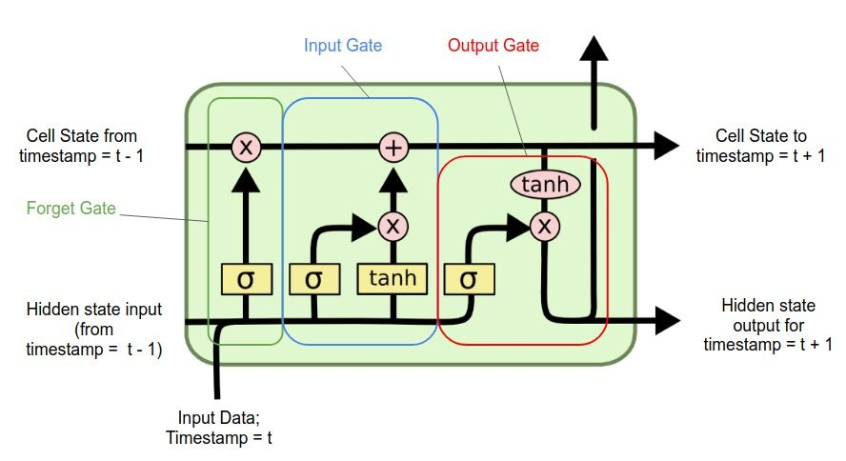
LSTM State

Slide 15
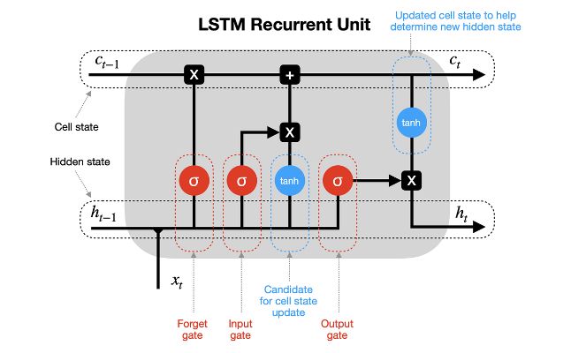
LSTM State

Slide 16
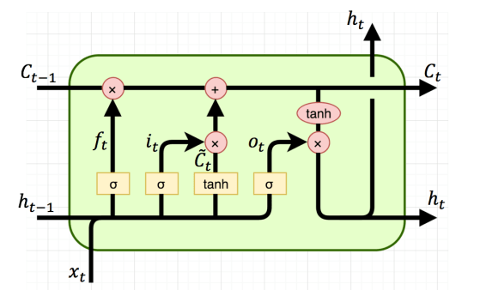
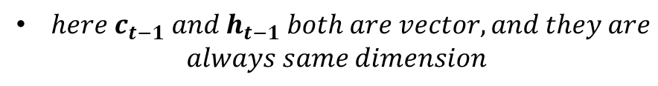
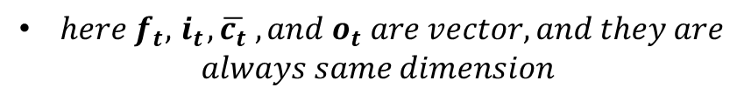
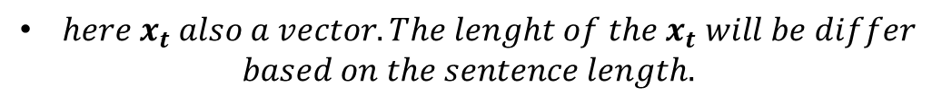
LSTM State
$here c_{t−1} and{ h}_{t−1} both are vector, and they are$
$$always same dimension$$
The dimension or shape of c_{t-1} and h_{t-1} same as number
Of neural network nodes or units.
$here x_{t} also a vector. The lenght of the{ x}_{t} will be differ$
$$based on the sentence length.$$
Timestamp will be the max length of the sentence. If in our
Document the max length of a sentence is 50 then time-stamp
Will be t₁ to t₅₀
h_{t-1}
b₁
$here f_{t},{ i}_{t}, \overline{c_{t}} ,and o_{t} are vector, and they are$
$$always same dimension$$
σ
f₁
σ
b₂
f₂
[f₁, f₂ , f₃] = f_{t}
σ
b₃
x_{t}
f₃

Slide 17
LSTM Gate Operation

Slide 18
LSTM Gate Operation

Slide 19
References
https://colah.github.io/posts/2015-08-Understanding-LSTMs/

